Slide 1
Hiring Process Analytics

Slide 2
Project description
Given a dataset of previous hirings across departments of a company.
Our job is to find out major trends and insights of the hiring process from the given data.
Data provided includes:
- Application_id
- Interview Taken on
- Status
- Event_name
- Department
- Post Name
- Offered salary

Slide 3
Approach
Understanding the data
Getting familiar with the data values and attributes
Analysing the data by applying filters and formulas
Visualise the data with graph/ charts to get better understanding
Tech stack used
Microsoft Excel

Slide 4


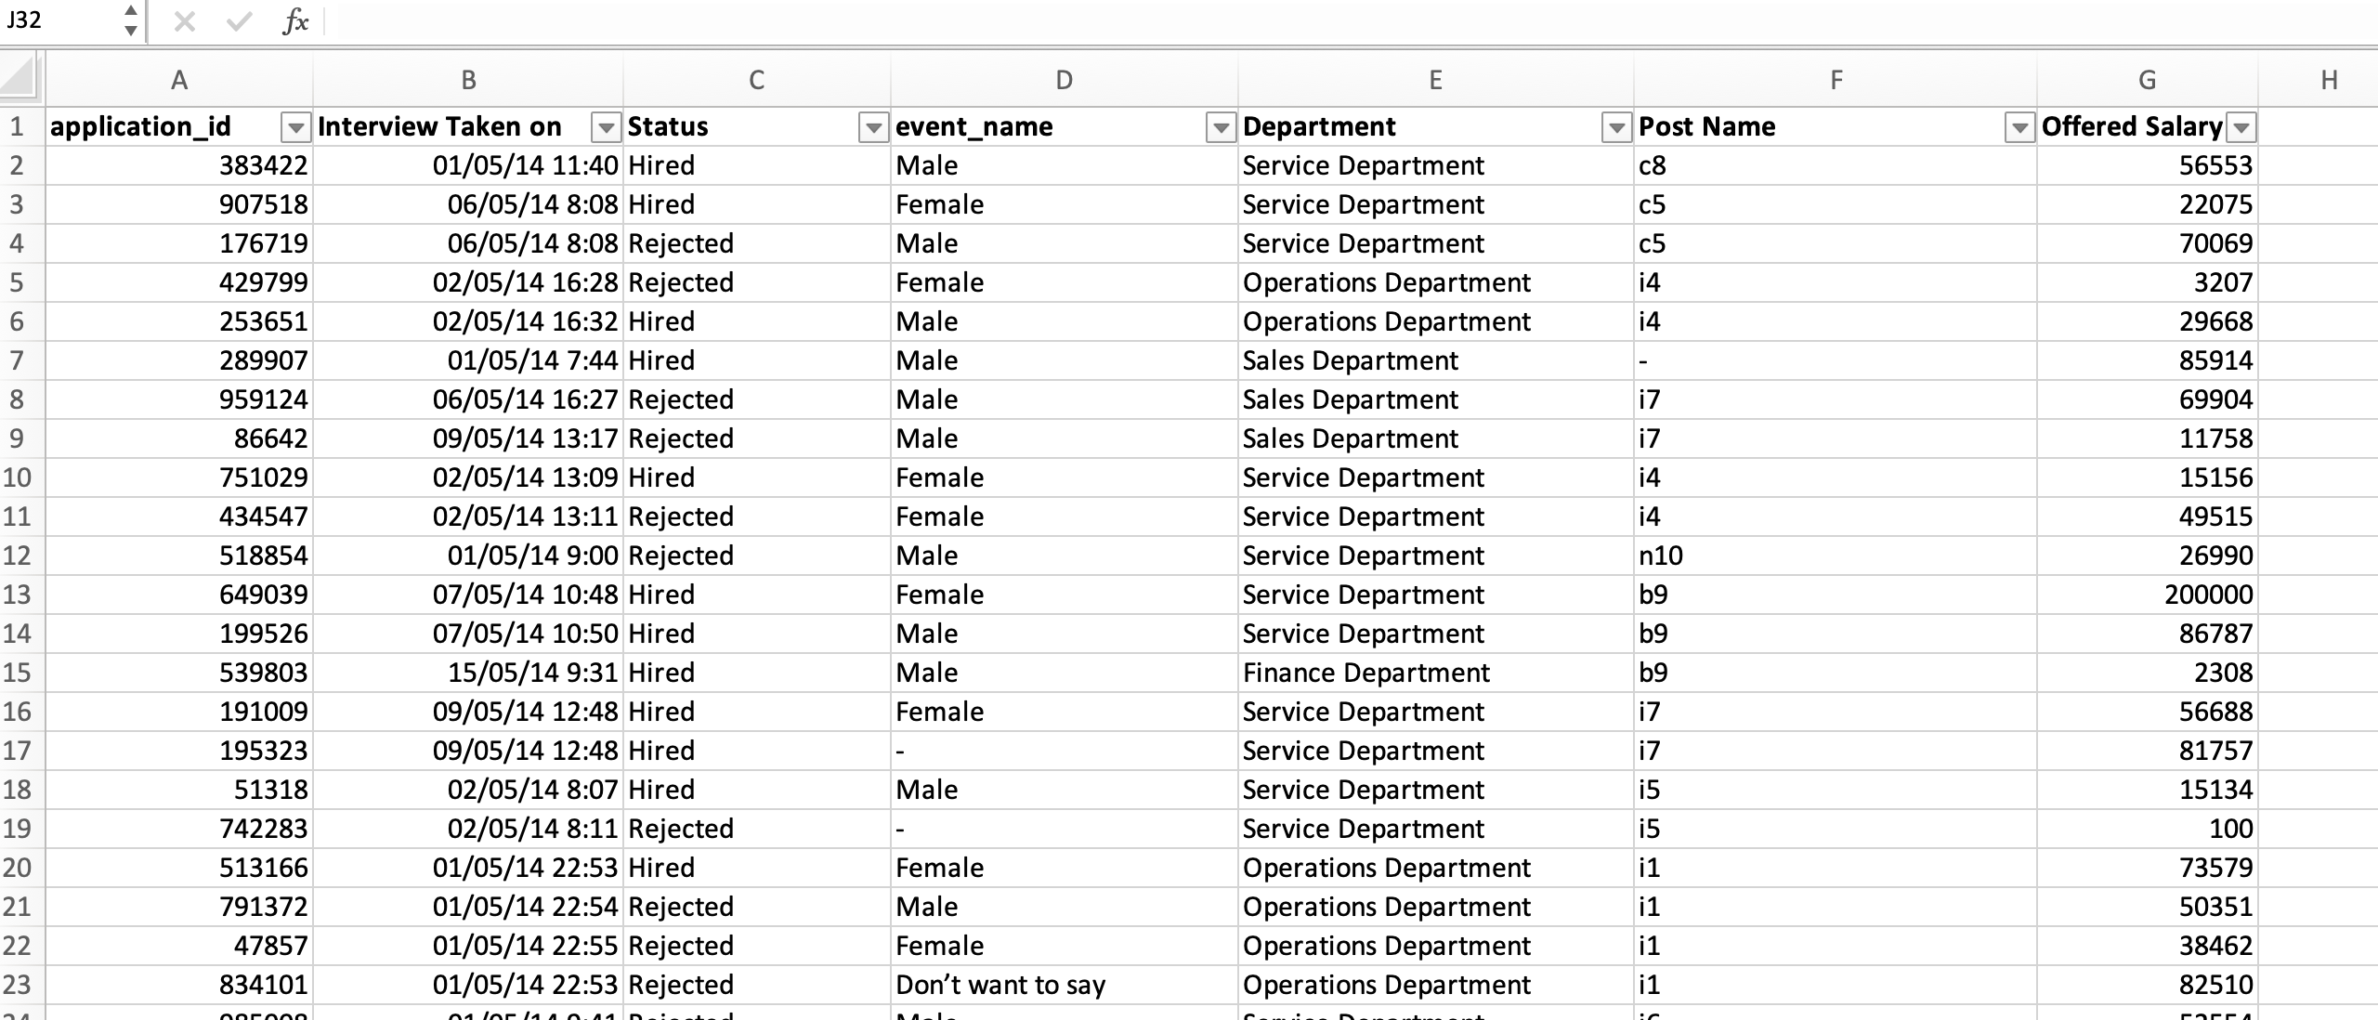
Hiring dataset

Slide 5
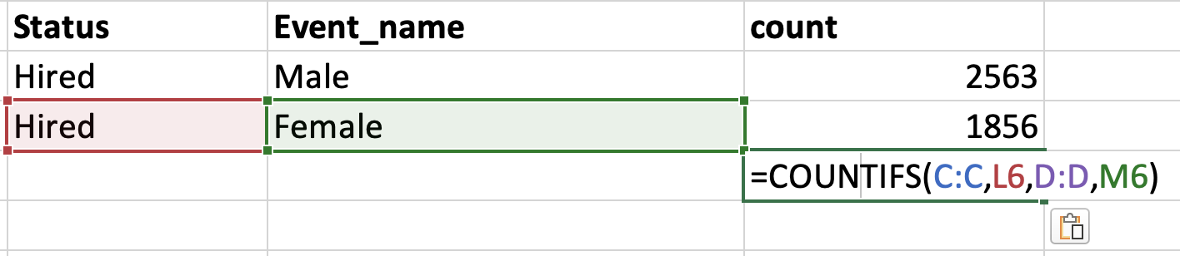
A. Hired males and females
=COUNTIFS(C:C,L5,D:D,M5)
SQL Query:- select count(status), event_name, status from hiring_data where status = "Hired" group by event_name;

Slide 6
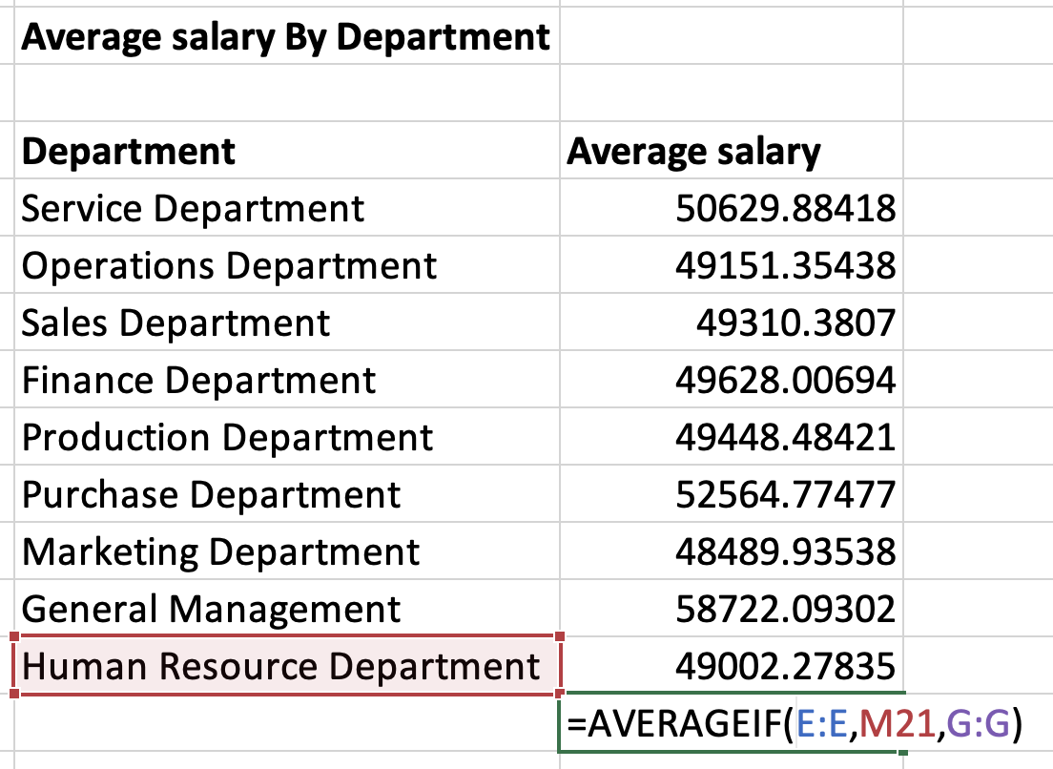
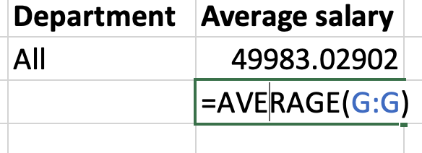
b. Average salary
=AVERAGEIF(E:E,M21,G:G
SQL Query:- select department, round(avg(salary),2) from hiring_data where status = "Hired" group by department;
=AVERAGE(G:G)

Slide 7
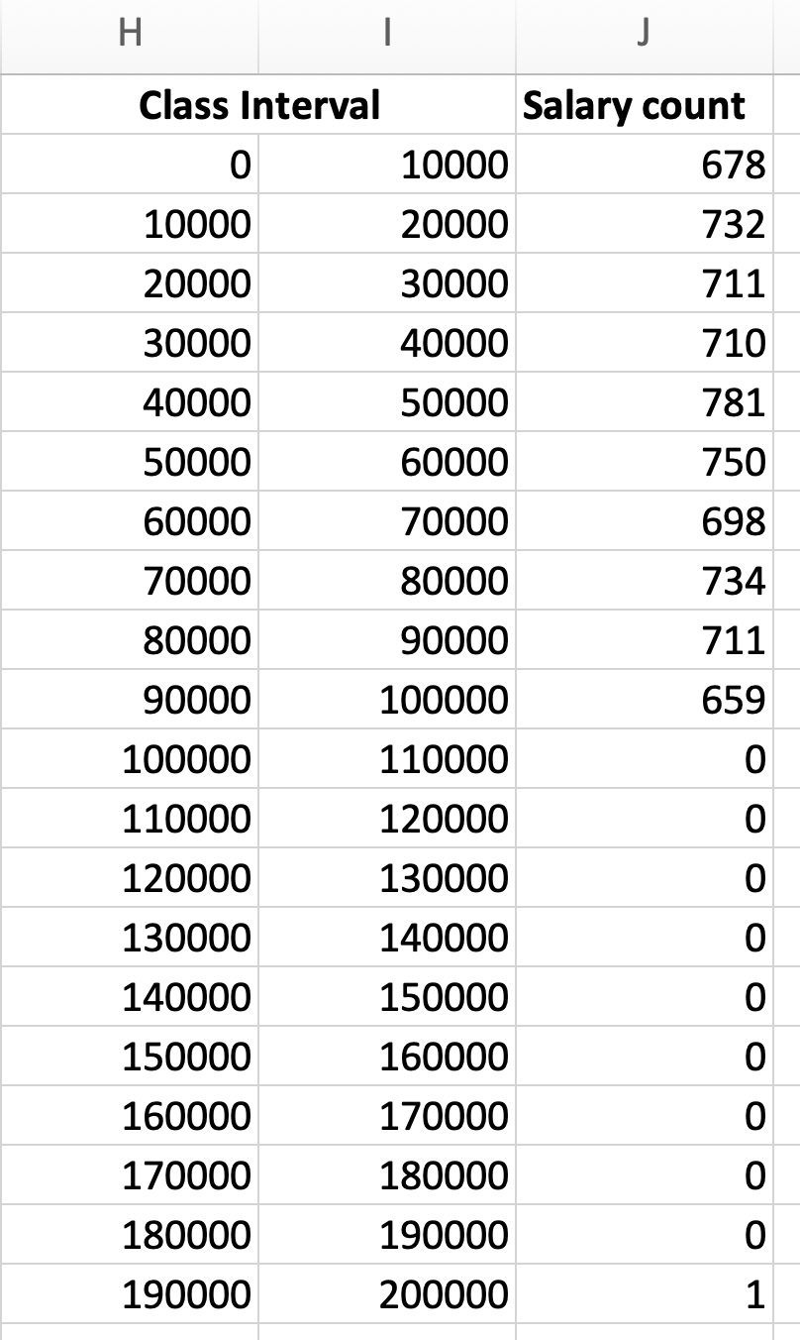
c. Class intervals of salary

Slide 8

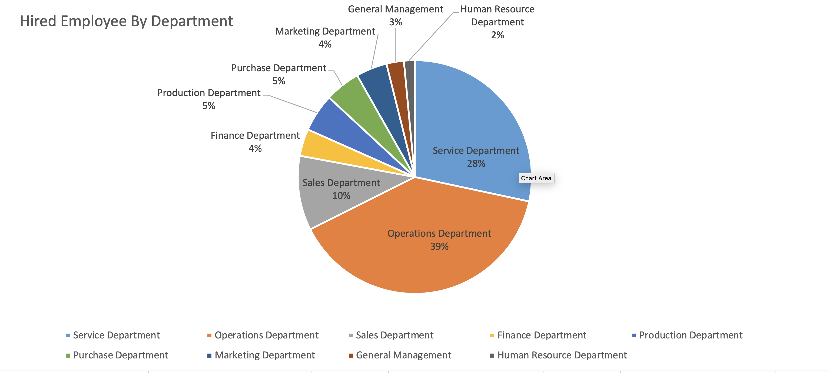
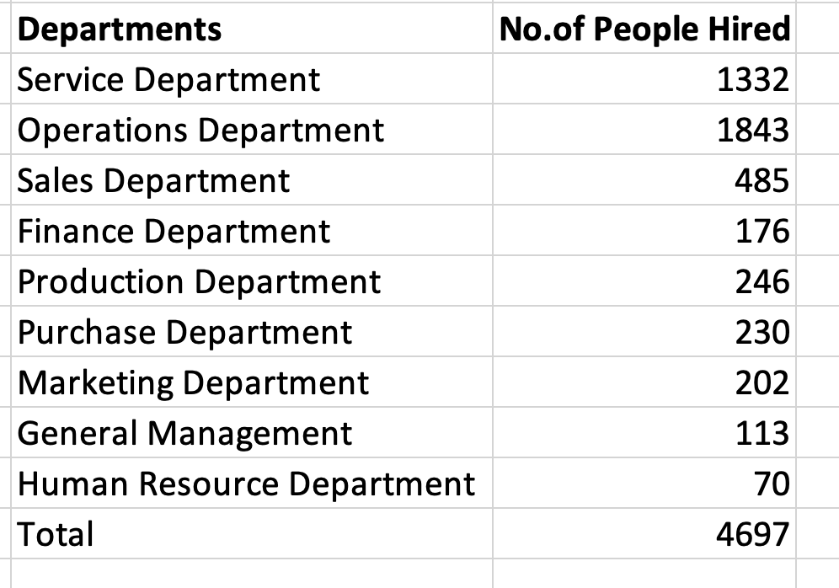
d. People hired in different departments
SQL Query :- select department, count(status) from hiring_data where status = "Hired" group by department;

Slide 9

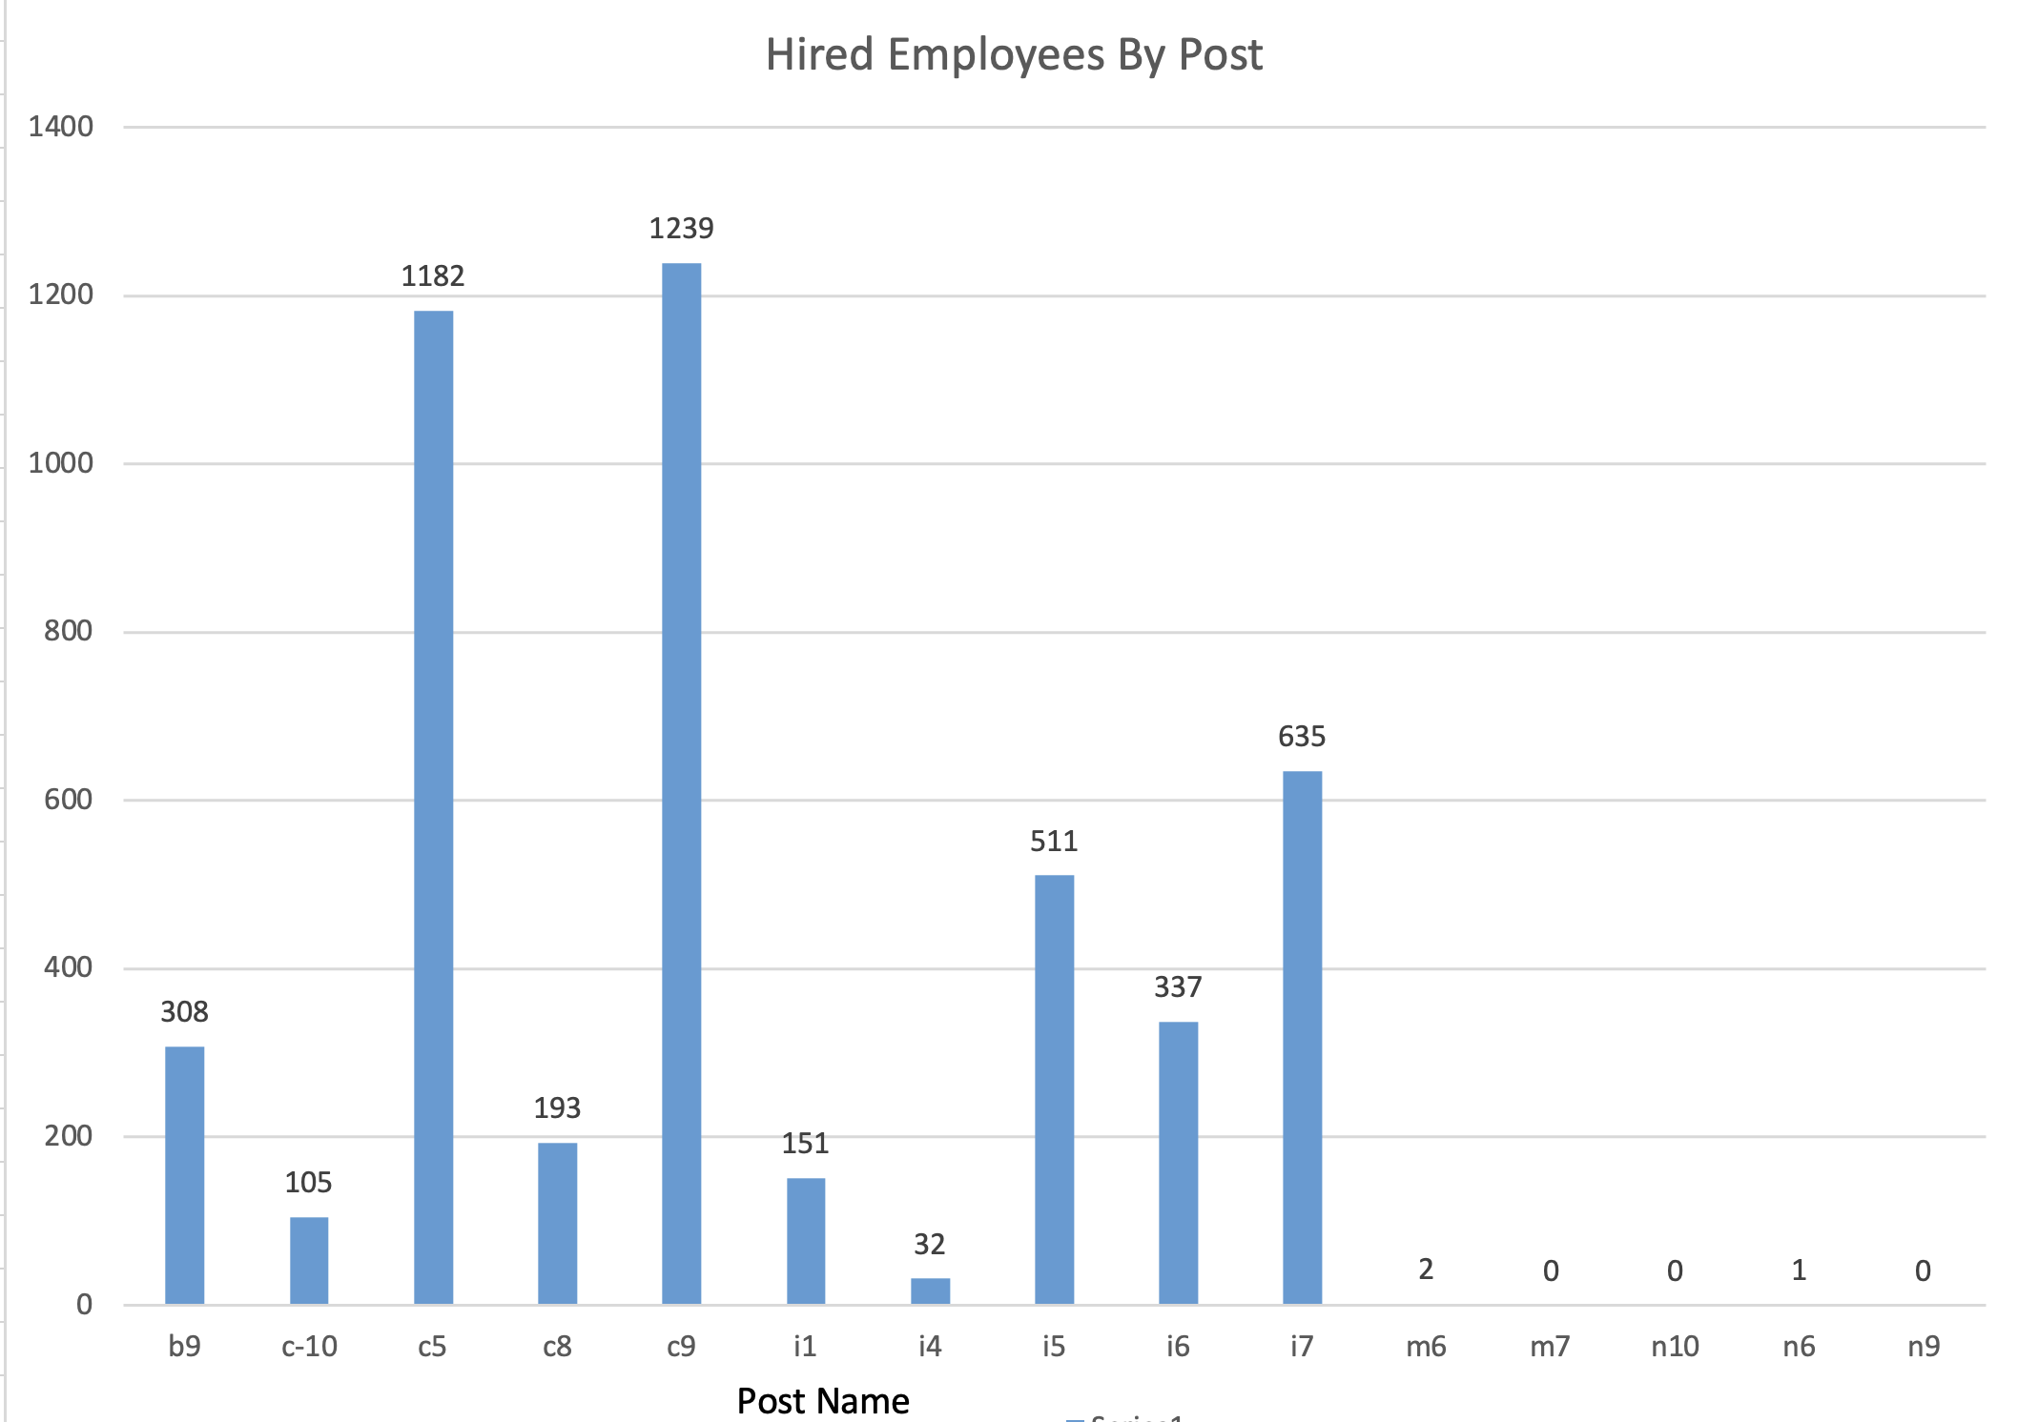
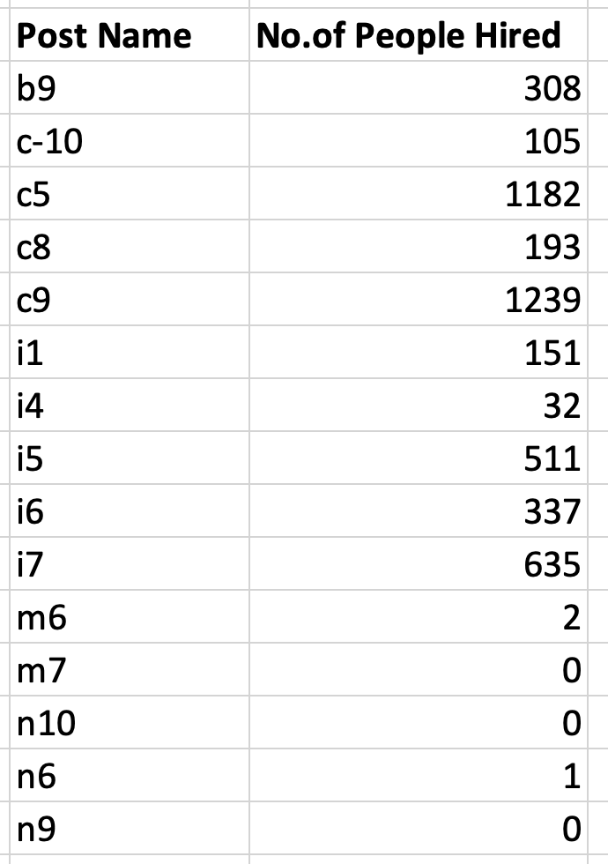
e. People hired by post
SQL Query:- select postname, count(status) from hiring_data where status = "Hired" group by postname;

Slide 10
Result/insights
In the analysis, I find the following conclusions:
There are more males hired then females.
Maximum average salary is offered by ‘General Management’ department and minimum average salary is offered by ‘Marketing Department’
Maximum hiring happened in ‘Operation Department’ and minimum in ‘HR Department’
Maximum no. of people hired for ‘C9’ post

